Slide 1
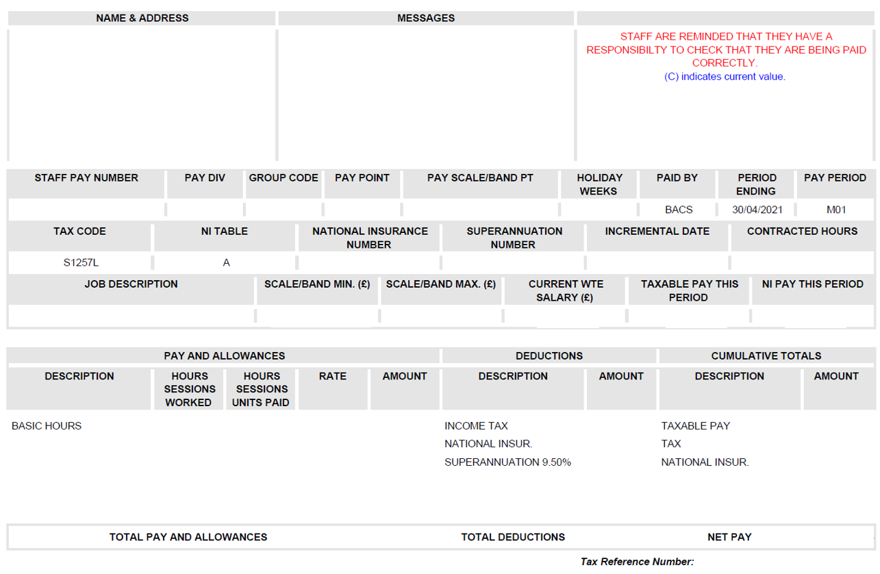
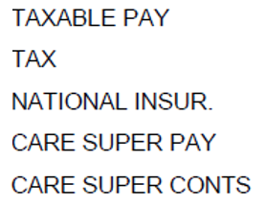
Your Payslip Explained
There are many factors that determine your pay each month. So, if you have a query regarding your payslip, make sure you contact the right person, area or organisation to get your query resolved quickly. Below are some pointers on who you should contact depending on the problem.
This is a representation of an ePayslip – paper payslips might not be displayed in the same way, but the guidance below remains the same.
Further guidance can be found on the NES Intranet or the TURAS Hub.
Contracted Hours
The hours in your contract generally indicate the hours you are paid for. If you work LTFT and have out-of-hours duties, your payment may be based on different hours that accounts for your OOH responsibilities. For enquiries about your paid hours, please contact us via the NES ServiceDesk.
You can view your ePayslip on ePayroll
Your contact details
If you need to update your name or address, you can do this via the
NES ServiceDesk.
Mrs Jane Smith
1 Scotland Way (C)
Edinburgh (C)
Scotland (C)
EH1 1SC (C)
This is where you’ll find key messages relating to your pay.
Salary Scale / Range
This represents your salary range and specific pay point. For more details on Pay and Terms & Conditions, visit MSG.
Internal payroll codes
These are used by Payroll to identify you, your organisation and where you are in the structure.
X1234567
X95
19
22
303C/03
Taxable Income for This Period
This figure represents the portion of your earnings that are taxable during this period. Please note that pension contributions are exempt from taxation.
Tax Code
Your tax code is issued directly by HMRC. If you suspect that your tax code might be incorrect, you can verify it by going to the gov.uk website.
XX123456BX (C)
1234567/890 (C)
01/02/2021
37.00
Your job title will appear here
£21,709
£23,603
£23,603
NI Contribution for This Period
This refers to the portion of your earnings that will be liable for National Insurance during this pay period (weekly or monthly).
BASIC HOURS
OT Hrs 1/2
National Insurance (NI) Number
If your NI number is incorrect, please contact NES through the Finance ServiceDesk.
Cumulative Totals
Your total taxable earnings for the year to date and your pensionable pay (Care Super Pay).Additionally, it specifies your pension contributions (Care Super Conts) along with the tax and National Insurance deductions applicable for the current tax year.
1234567
Your Pay and Allowances
If you have concerns about your salary, first reach out to your line manager, as they communicate any changes to your terms and conditions to NES HR. For expense-related issues, please contact your line manager as well. DDiTs should connect with their Placement Board.
If you need more help after that, please submit a request to NES via the Finance ServiceDesk.
NHS Employer
This is the Board responsible for your employment.
Deductions
This shows you your Income Tax and NI deductions for the month, as well as your Superannuation (pension) and any other deductions specific to you (e.g. childcare vouchers, trade union membership etc.). If you have a query or need further information on your pension, please visit SPPA website. Your NI contributions are based on your employment status and earnings. Visit the gov.uk website for more information.
Tax Reference Number
This is required when contacting HMRC.

