Slide 1

RAIGMORE HOSPITAL MEDICAL STAFF
INDUCTION DAY
TRANSFUSION
- getting it right !

Slide 2
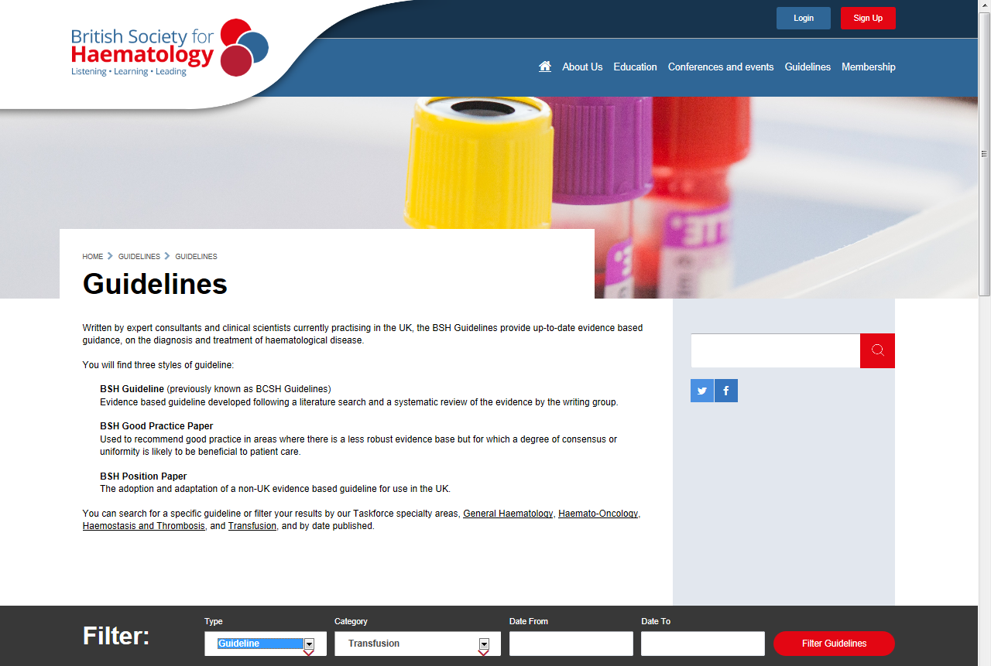
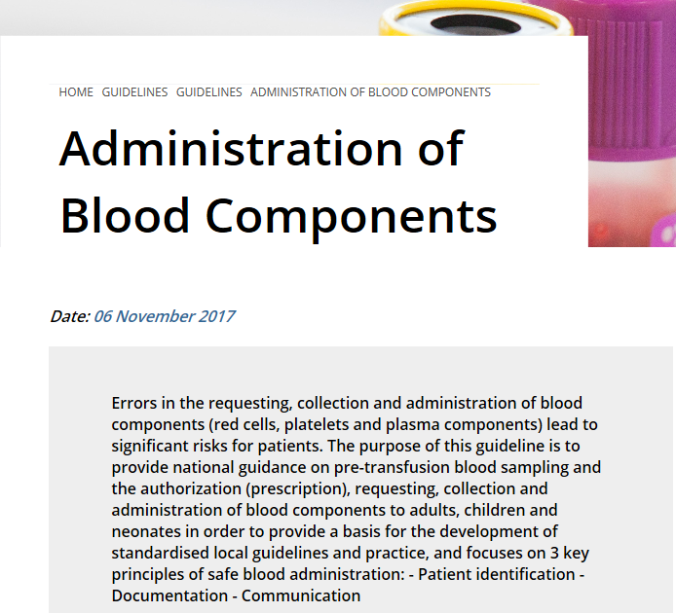
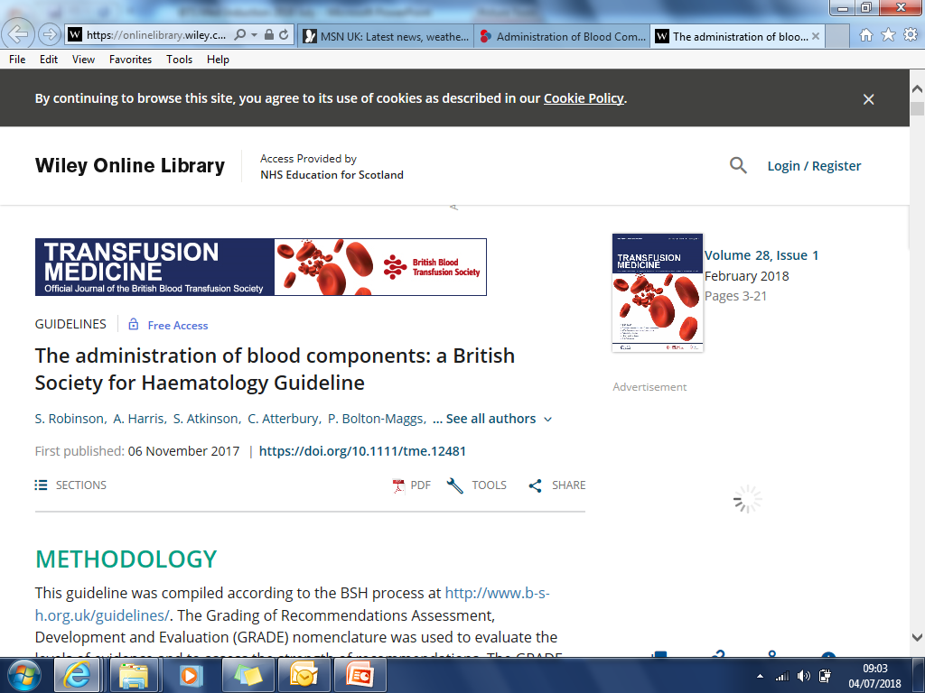
Transfusion Guidelines

Slide 3
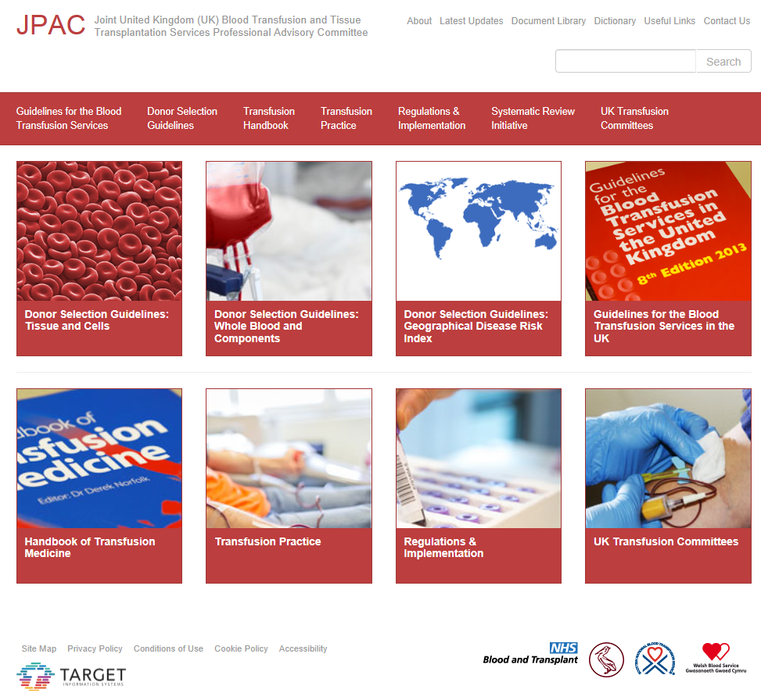
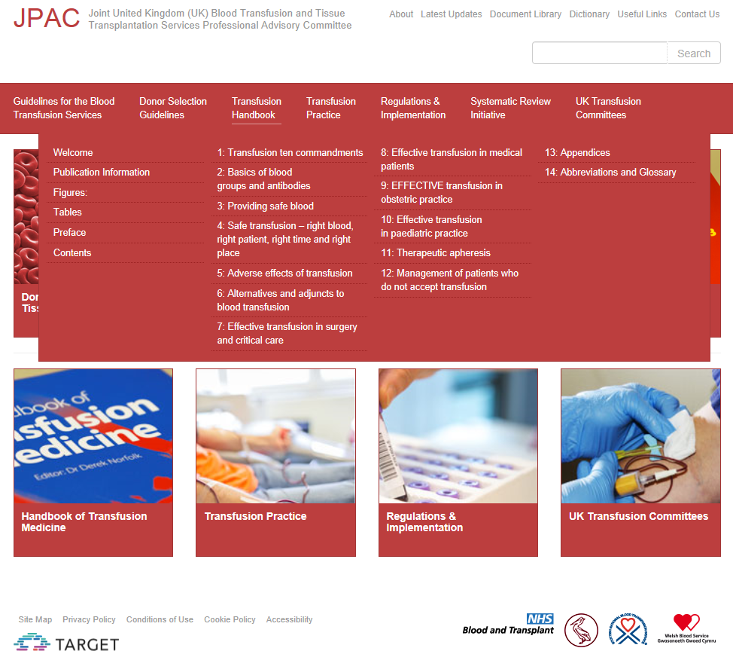
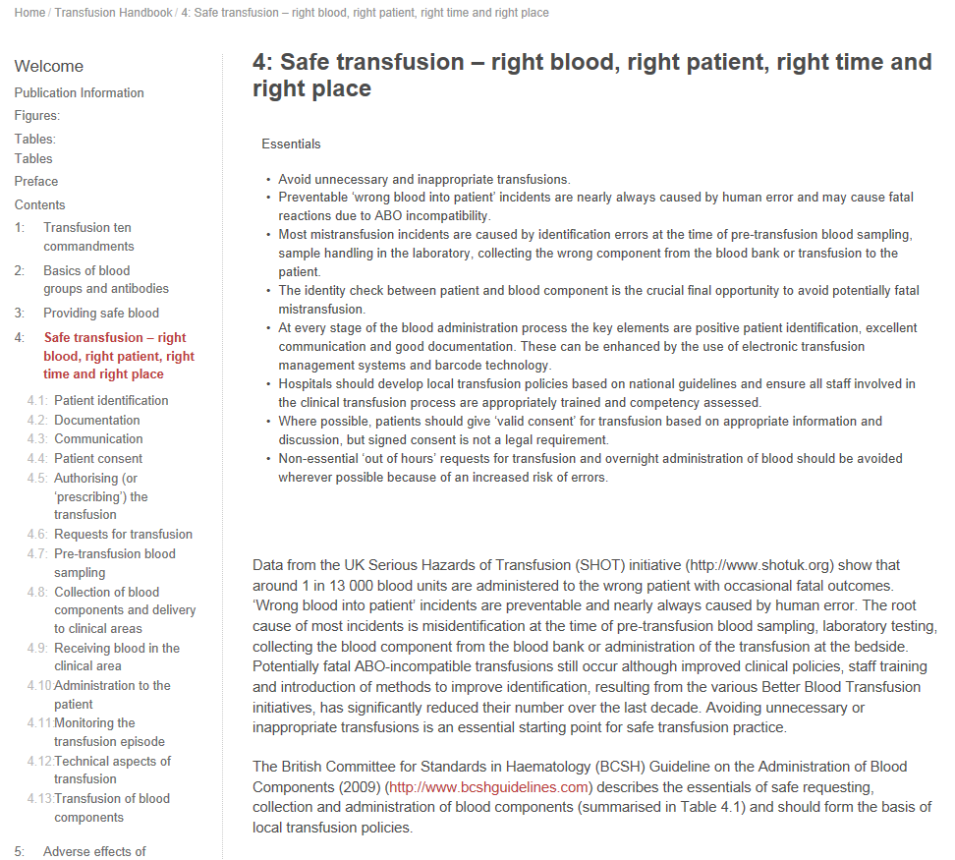
Transfusion Guidelines

Slide 4
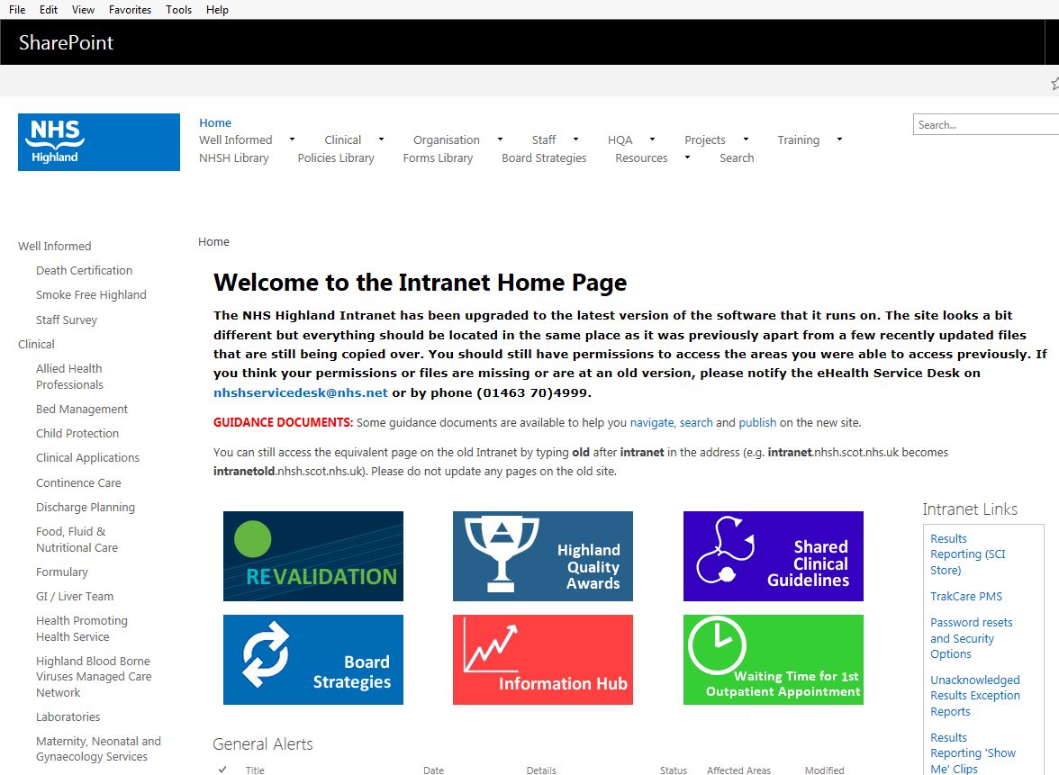
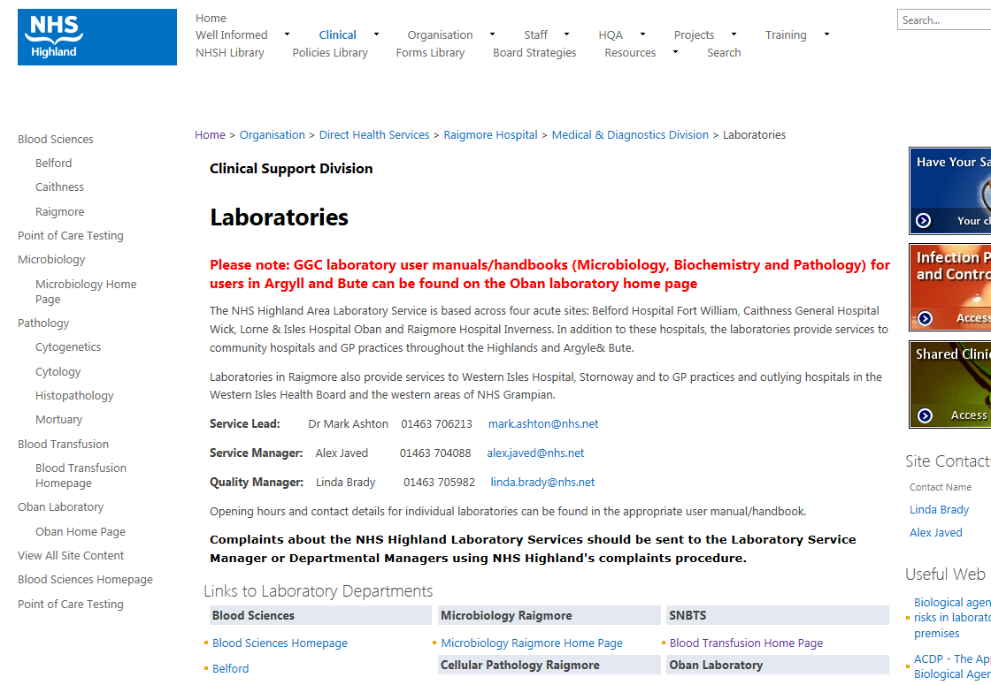
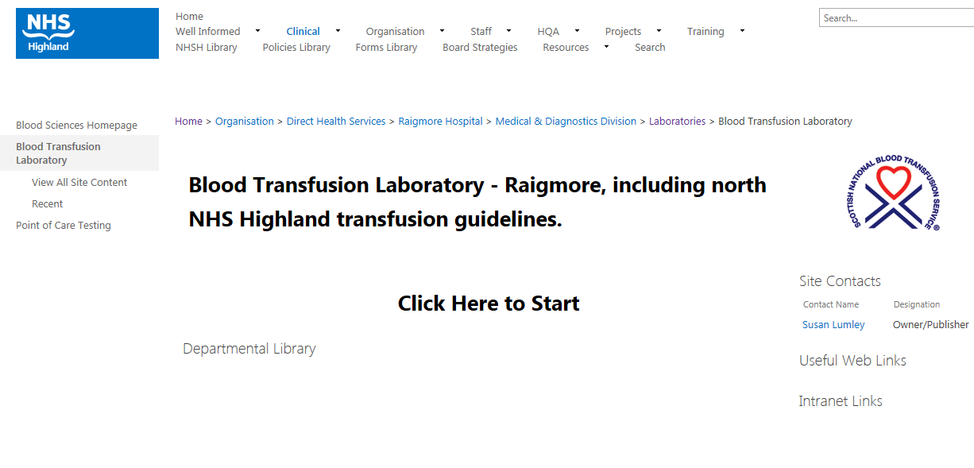
NHS Highland Intranet

Slide 5
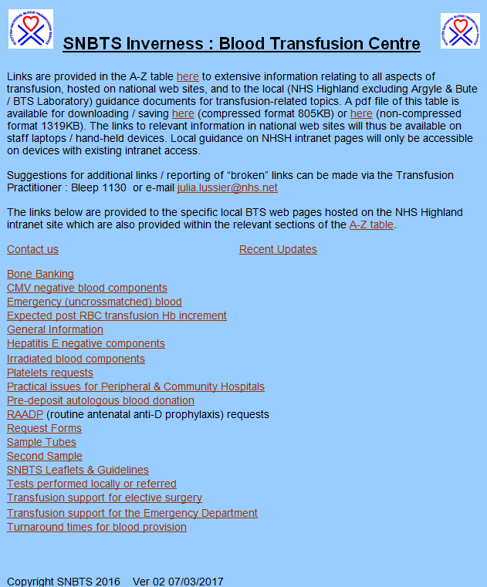
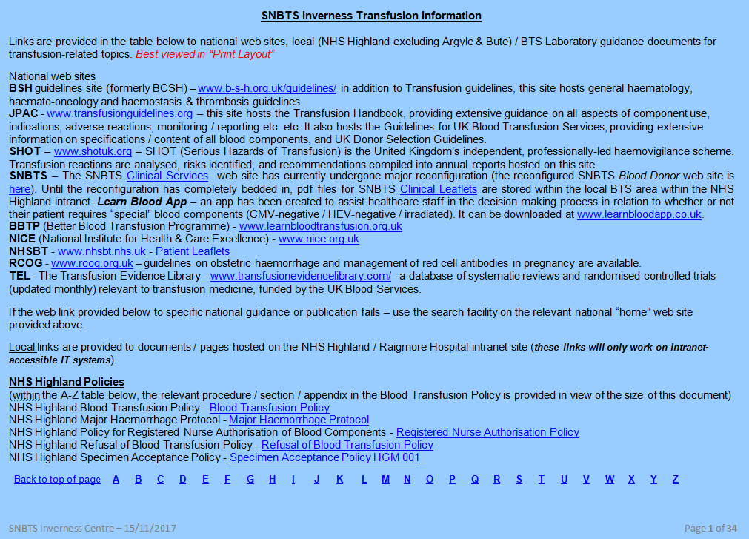
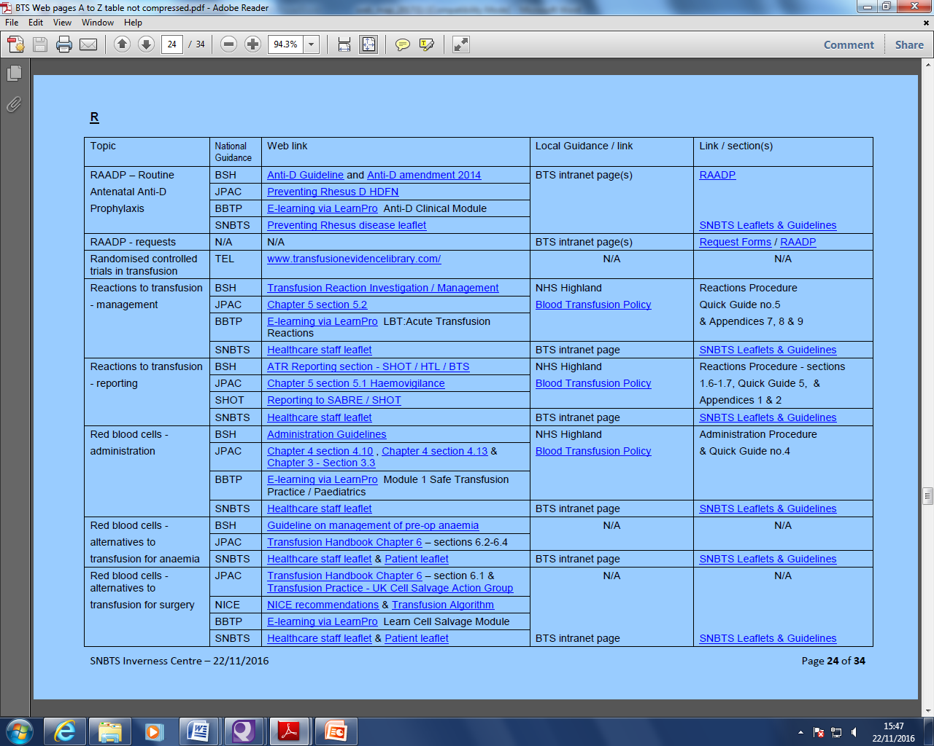
NHS Highland Intranet BTS Pages
Links provided to relevant national guidelines

Slide 6
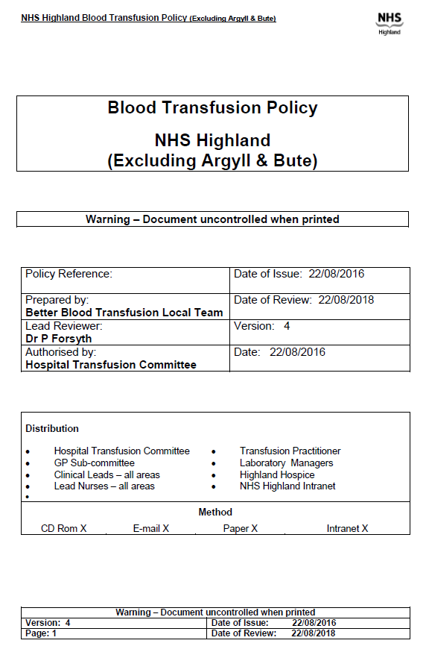
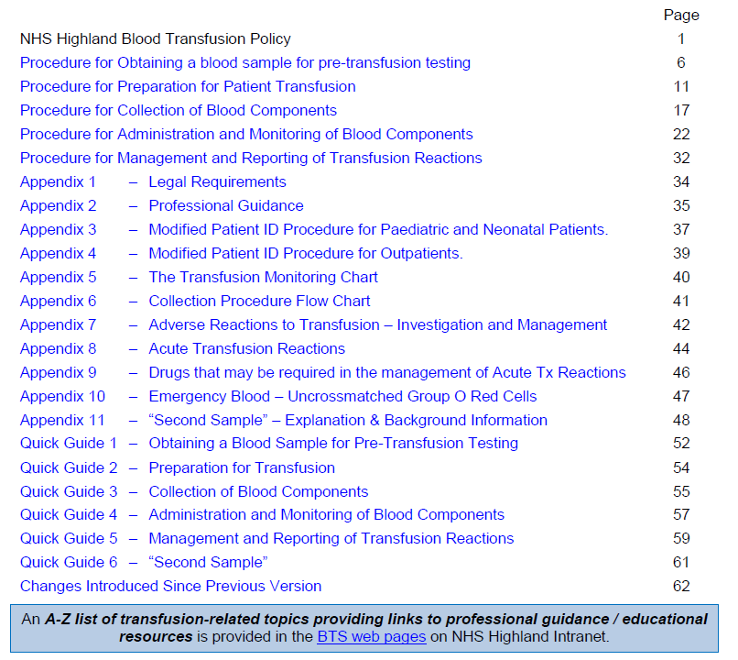
NHS Highland Transfusion Policies

Slide 7
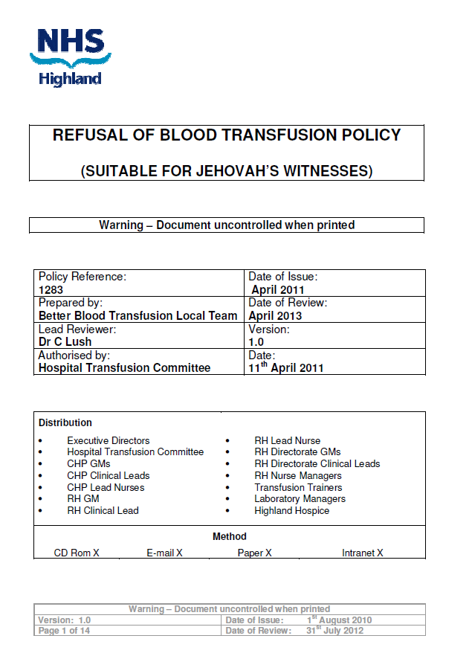
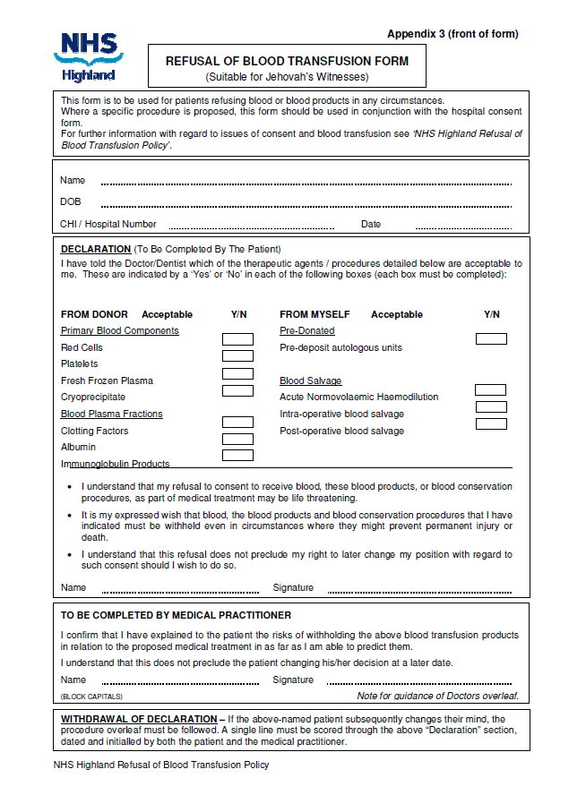
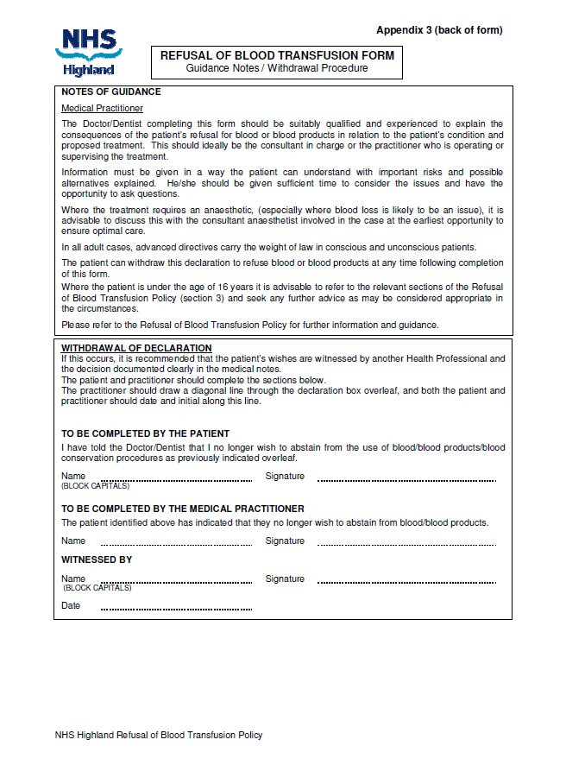
NHS Highland Policies

Slide 8
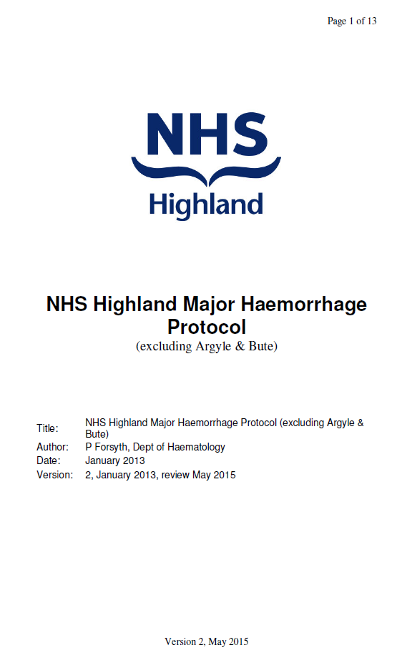
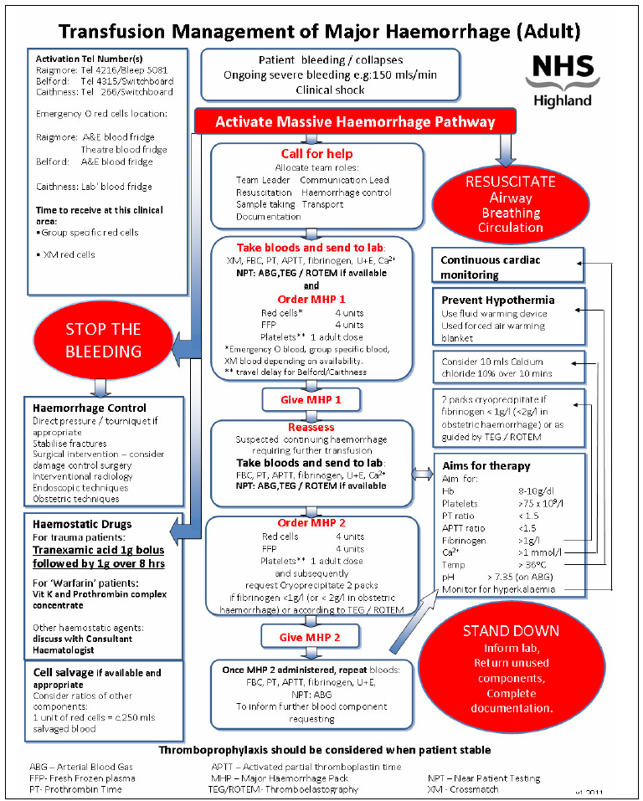
NHS Highland Policies

Slide 9
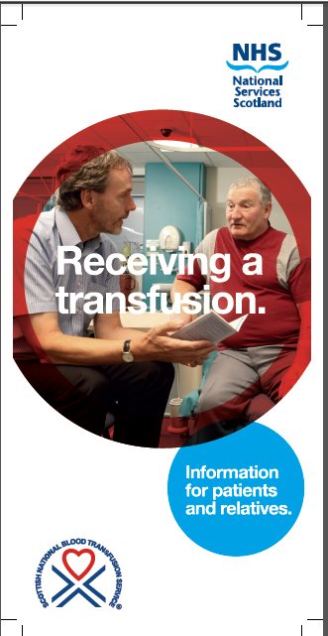
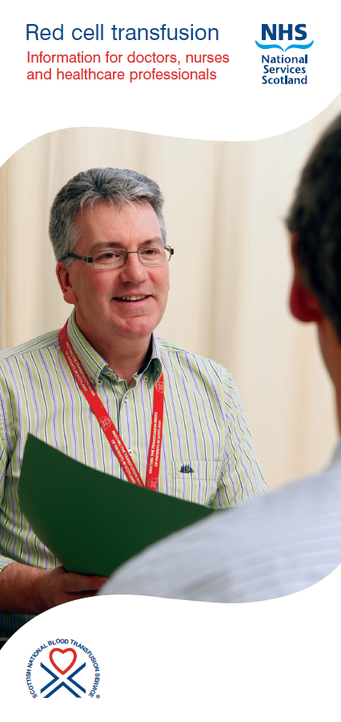
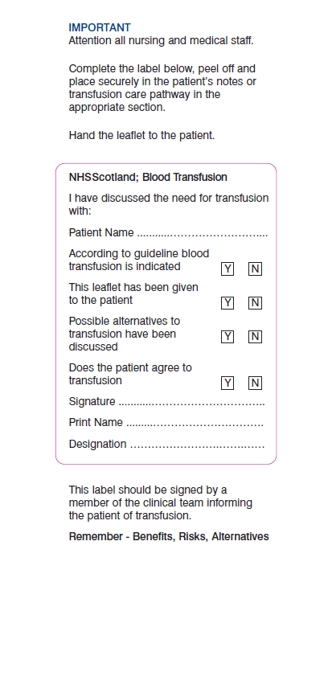
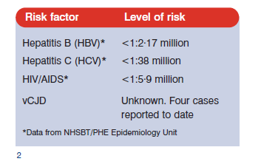
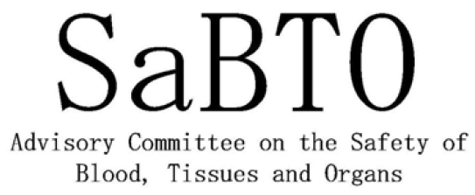
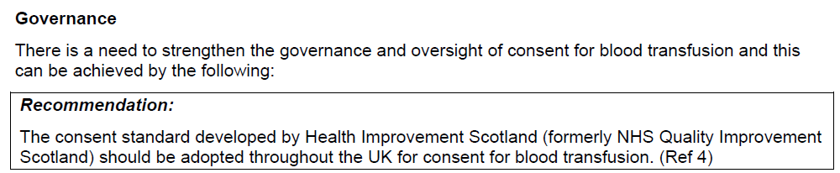

Slide 10
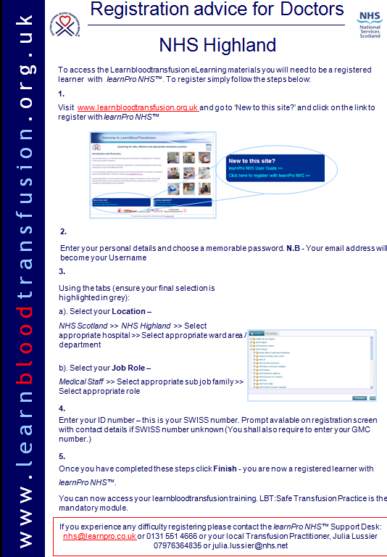
Mandatory Transfusion Training
All staff involved in the clinical transfusion process must complete
LBT: Safe transfusion practice which can be accessed via www.learnbloodtransfusion.org.uk
The training will take approximately 1 hour to complete and must be revalidated every 2 years.
You must complete this training prior to commencing in your clinical area

Slide 11
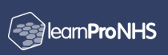
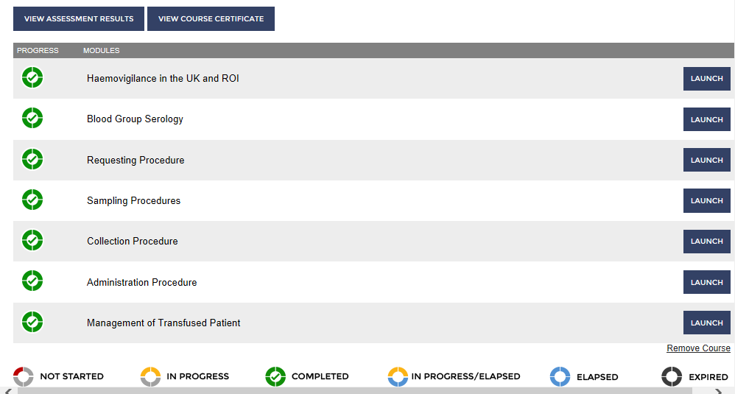
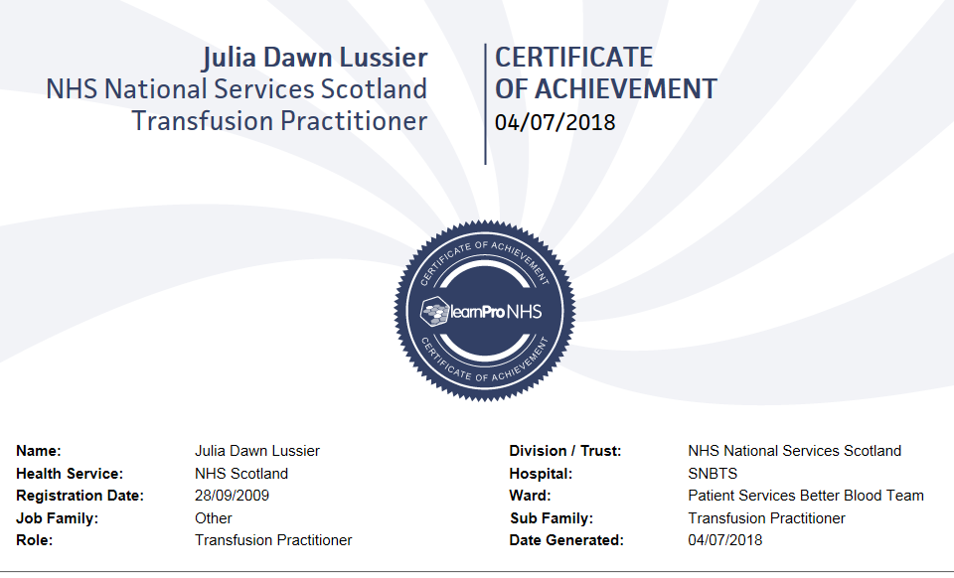
Username : Active e-mail
Unique Identifier: SWISS / GMC No.
Complete
LBT: Safe Transfusion Practice
Print Certificate
If already registered & completed
– visit site to update your details (hospital / ward discipline using the red profile tab on the home page etc.)

Slide 12
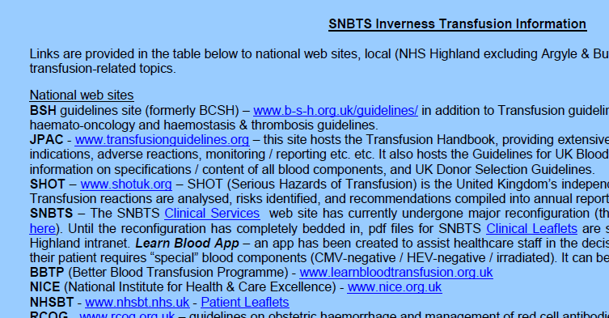
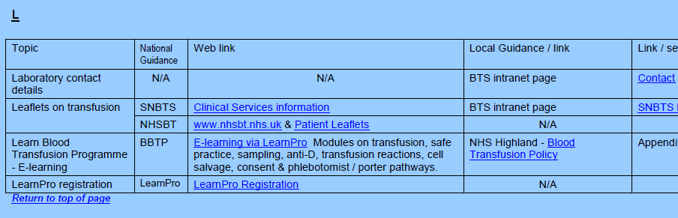

Slide 13
24-Hour Service
Daytime - ‘phone the Lab - ext 4216
OOH - Contact via switchboard
BMS staff on shift – may be elsewhere in Department
Medical staff NOT resident (local Consultant Haematologists / SNBTS national on-call medical Consultants)
OOH samples
Non-elective (plus pre-op next day up to 10pm)
After 10pm – non-elective samples only
Contact BMS to inform that sample en route
Non-urgent / “routine” samples sent OOH will not be processed until the following working day.
If time required / degree of urgency is not provided on request form, Lab will contact MO irrespective of time.
All samples - indicate degree of urgency / when required – allows BMS to prioritise
Include transfusion patients in handover to colleagues

Slide 14
The Transfusion Problem Label
HOSPITAL No.
R235117W
SURNAME
FORENAMES
HEBWORTH
MARILYN
HEBWORTH
MARILYN
DATE
TRANSFUSION
PROBLEM
HOSPITAL
HIGHLAND HEALTH BOARD
23/03/04
Raigmore
SURNAME
FORENAMES
R235117W
HOSPITAL No.
CONFIDENTIAL
NOT TO BE HANDLED
BY THE PATIENT
HEBWORTH
MARILYN
09 / 11 / 22
24 The Street
INVERNESS
Raigmore Hospital
R235117W
Mr A Surgeon
4A
Alloantibody screen
Mr A Surgeon
Dr A Physician
Ward 1A
Raigmore Hospital
INVERNESS
Dr A Practitioner
Crown Medical Practice
Inverness
6154381
Clinically Important Result
Serum contains anti-Jka alloantibody
A delay in the provision of compatible blood is possible
23/3/04
DATE
TRANSFUSION
PROBLEM
23/3/04
22/11/98
22/11/98
23/11/98
DATE
TRANSFUSION
PROBLEM

Slide 15
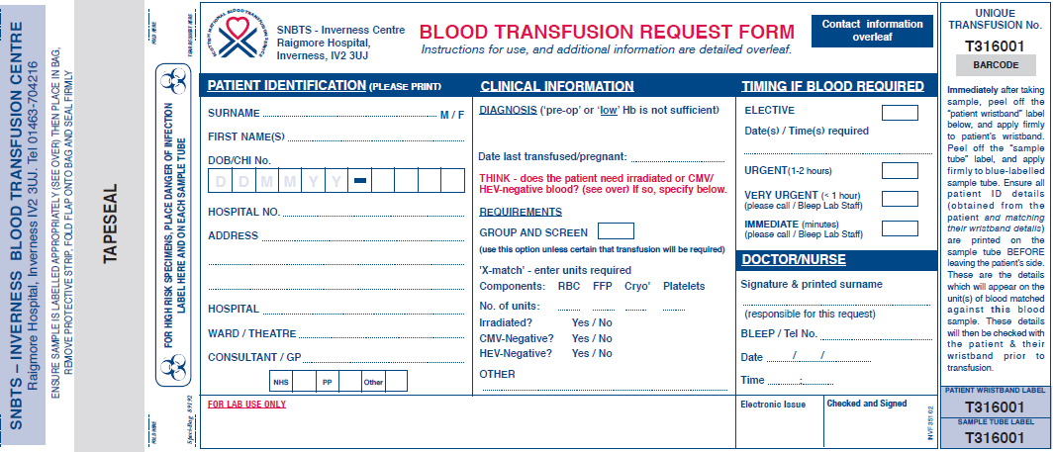
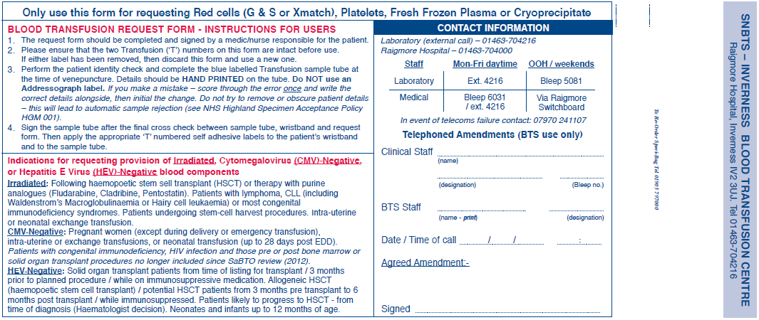
Design of Blood Transfusion Request Form
Red cells
Platelets
FFP
Cryo
7.5ml EDTA
– adults & infants > 4 months
Must have at least 3-4 mls
to avoid requests for repeat samples
1.2ml EDTA
- neonates ≤ 4 months

Slide 16
Test Request Form / Tubes
Serology Ix (antenatal / haemolysis)
7.5ml EDTA
– adults & infants > 4 months
Must have at least 3-4 mls
to avoid requests for repeat samples
ALBUMIN (4.5% or 20%) & IV or hyperimmune immunoglobulin
are ordered from PHARMACY not BTS.
1.2ml EDTA
- neonates ≤ 4 months

Slide 17
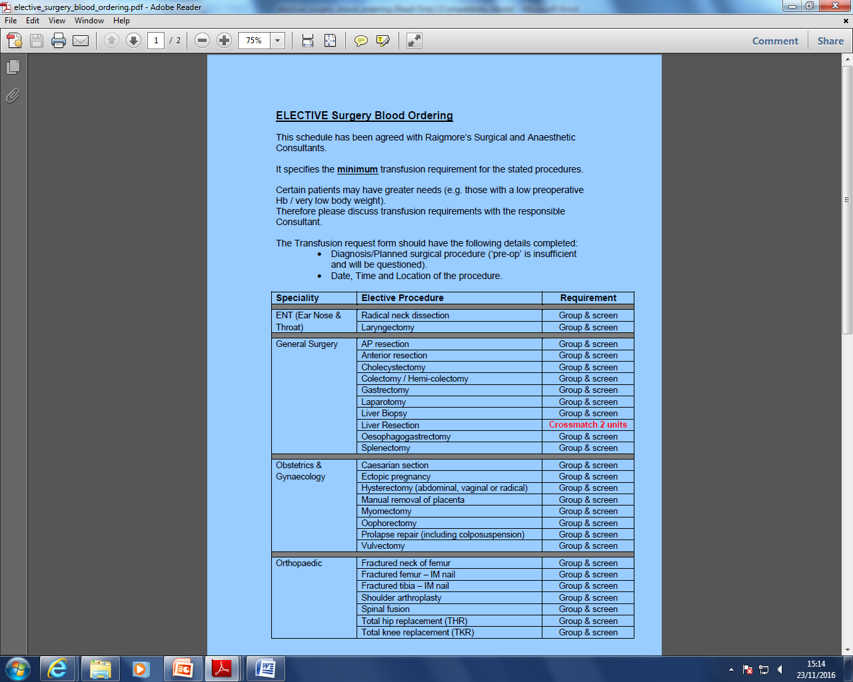
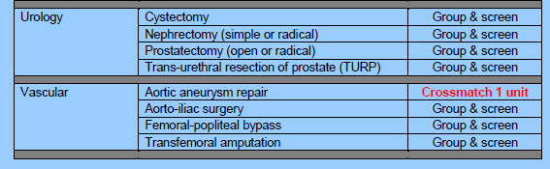
“MSBOS / MTRES”

Slide 18
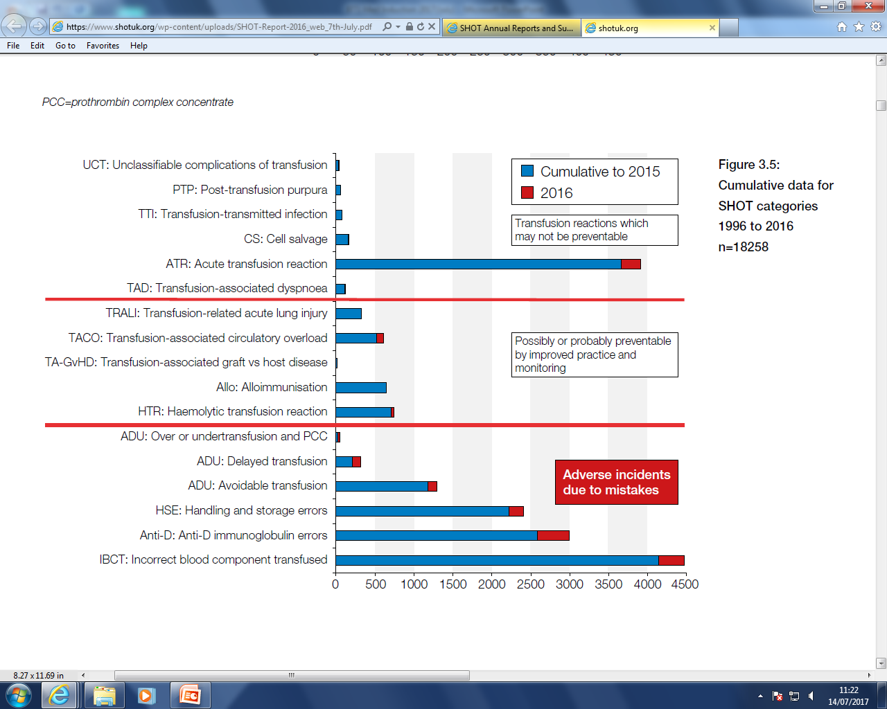
Serious Hazards of Transfusion (SHOT)
2016 - 3/26 definite,
8/26 probable, 15/26 possible
Of which 16 (62%) preventable
UK – 2.5 x 10⁶ blood components transfused in 2016
Risk per million components – death 10, major morbidity 49 (SHOT report 2016).
Cumulative data for SHOT categories 1996-2016 (n=18,258)
“Wrong blood”
Adverse events caused by error
sample from wrong patient
unit collection errors
failure of final bedside checking
failure to request “special” requirement (e.g. irradiated)

Slide 19
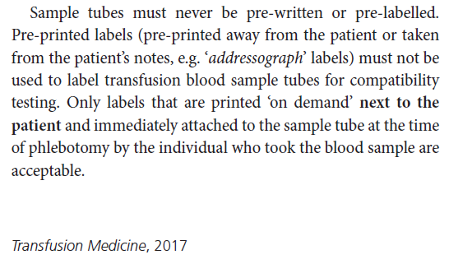
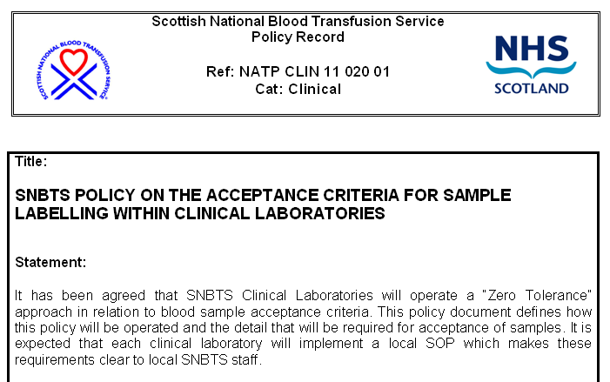
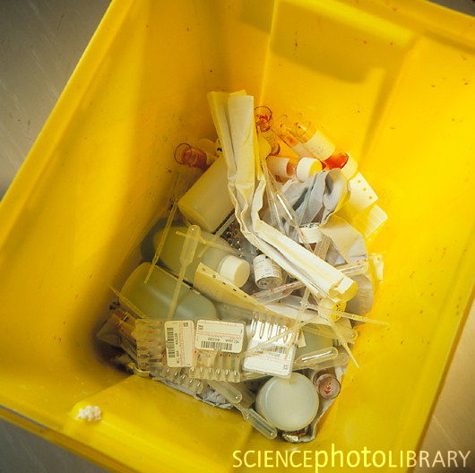
BSH 2017
BLOGGS Joseph 27/05/1938
36 The Street, Inverness
R123456X 270519381234

Slide 20
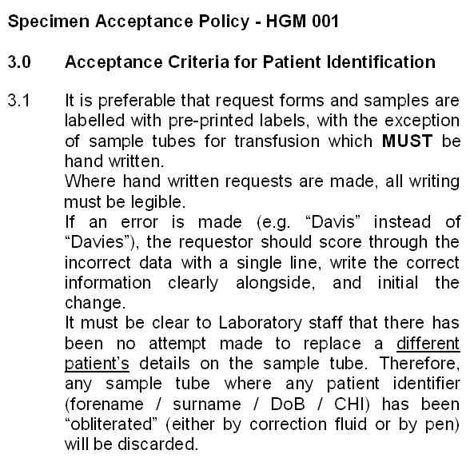
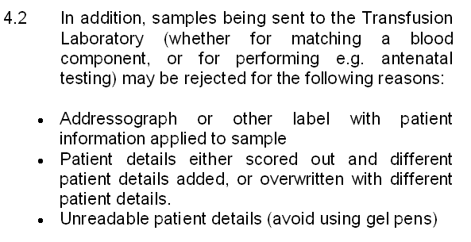
DAVIS
DAVIES
FEMALE
JANICE
2806581234
MEDICAL
28/06/1958
15/09/2014
ANOther
DAVIS
DAVIES
FEMALE
JANICE
2806581234
MEDICAL
28/06/1958
15/09/2014
ANOther
DAVIES
FEMALE
JANICE
2806581234
MEDICAL
28/06/1958
15/09/2014
ANOther
DAVIS
DAVIES
ANO
FEMALE
JANICE
2806581234
MEDICAL
28/06/1958
15/09/2014
ANOther

Slide 21
Labelling The Sample For Blood Transfusion
1. Print Patient’s Details On Tube
Include time sample taken on form, otherwise Lab IT system automatically defaults to 00.01hr that day, thereby reducing time available for use in matching blood.
T 5 7 6 3 1 8
PATIENT WRISTBAND LABEL
Medical
11.05.49
15.11.19
ANother
CHI / Hospital No.
SMITH
JEAN
Female
SAMPLE TUBE LABEL
T 5 7 6 3 1 8
CHI 110549-1863 Hosp.No.R147638B
Date of birth
Medical
11.05.49
15.11.19
ANother
Name
2. Apply T Numbers To Wristband & Tube

Slide 22
“Unknown” Casualties
Temporary Hospital (TH) or Major Incident (MI) numbers allocated in A&E
Replace the name / DoB / CHI on sample and form
Additional information for Transfusion samples :-
Gender
Approximate age range – e.g. “10-20”, “60-70”
Reasons :-
Rhesus D negative RBC available, but in limited supply
(~15% donor population) so BMS need to prioritise.
Those born after 01/01/96 not exposed to vCJD via foodchain
UK policy to supply FFP from low risk country for such patients.

Slide 23
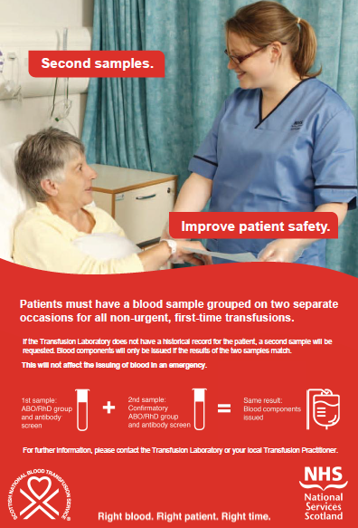
“Second Sample” Pre-Transfusion Requirement
Applies to non-urgent, first time blood component requests (national).
BCSH 2012 Guidelines – safer transfusion by reducing wrong blood in tube incidents.
Does not apply to :-
urgent blood requests
requests for infants up to 12 months of age
requests for patients whose blood group is already known to the Laboratory.
If the Laboratory receive a non-urgent,
pre-transfusion sample from a patient :-
over the age of 12 months,
with no prior blood group record,
we will contact the requester to inform you
that a second sample will be required
(to confirm the patient’s ABO group)
before blood will be issued.
TAKING 2 SAMPLES AT THE SAME TIME
NEGATES THE SAFETY MEASURE
PLEASE DO NOT DO IT

Slide 24
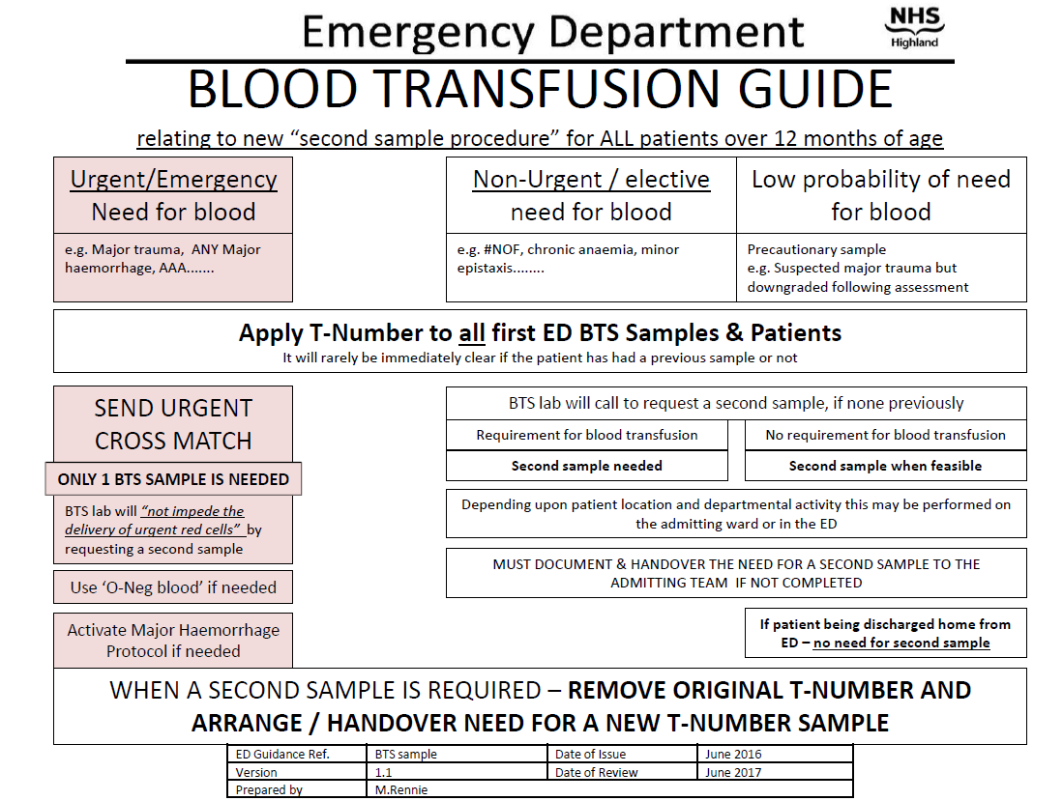
“Second Sample” Pre-Transfusion Requirement

Slide 25
Sample Turnaround Times
Clinical Risk Assessment
Laboratory testing prior to provision of red cells for transfusion :-
the risk to the patient from the amount of blood lost (tissue hypoxia), and
the risk to the patient from transfusion of “mismatched” red cells.
Need for Transfusion | Patient sample status | Time | Red cells | Comment
Immediate | No current sample | 0 mins | Emergency Blood - group O unmatched | Ensure T number sample taken before transfusion commences
Urgent | ≥ 1 current sample sent to Laboratory | 10-15 mins | ABO and Rh D compatible Antibodies not yet excluded. | Antibody screen and IAT crossmatch performed retrospectively. Clinical staff will be advised if results positive.
Elective – patient known to Lab database | all antibody negative | 1 hour | ABO and Rh D compatible red cells. Antibodies excluded. | Electronic issue of suitable red cells.
 | 1 current sample or previous antibody positive | ≥ 2 hours * | ABO and Rh D compatible red cells, negative by IAT crossmatch | Antibody identification may be completed retrospectively. * Mixes of antibodies take longer.
Elective – new patient | 2 current samples tested and antibody negative | 1.5 hours approx◻ | ABO and Rh D compatible red cells. Antibodies excluded. | Electronic issue of suitable red cells. ◻Extra time ~ obtaining 2nd sample.
 | 2 current samples tested and antibody positive | ≥ 2 hours * | ABO and Rh D compatible red cells, negative by IAT crossmatch ** | Antibody identification may be completed retrospectively. * Mixes of antibodies take longer.
Elective Surgery
Sample 1 – pre-assessment clinic. Sample 2 – admission for surgery (G&S).
ABO / RhD and antibody status known pre-theatre.
If blood required – ‘phone lab – 5-10 minute turn around (if antibody +ve – 2 units pre-prepared)

Slide 26
Checking The Compatibility Label Against The Patient’s Wristband
Name
Transfusion “T” No.
PATIENT WRISTBAND LABEL
T 5 7 6 3 1 8
Peel-off label, completed by ward staff commencing transfusion and attached to fluid chart.
Date of birth
CHI / Hospital No.
Confirmation of transfusion details completed by ward staff and returned (label and empty pack) to BTS Lab (EUD).
Always involve the patient by asking them to state their name and date of birth, where possible.
If there is ANY discrepancy - DO NOT transfuse.
Contact the Transfusion Laboratory.
If you are interrupted - STOP, and start the checking procedure again.
Do not leave the patient until the transfusion has commenced.

Slide 27
Legibility
= or ?
= or ?
= or or ?
I 2 3 4 5 6 7 8 9 0

Slide 28
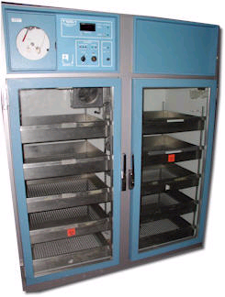
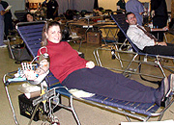
Transfusion Time - Upper Limits
Maintenance of red cell viability
Prevention of bacterial proliferation
120
100
80
60
no. of bacteria
40
20
0
1
2
3
4
5
6
time
4 hours maximum after removal from refrigeration to END of transfusion
Removal from refrigeration → initiation of transfusion
Initiation of transfusion → completion of transfusion

Slide 29
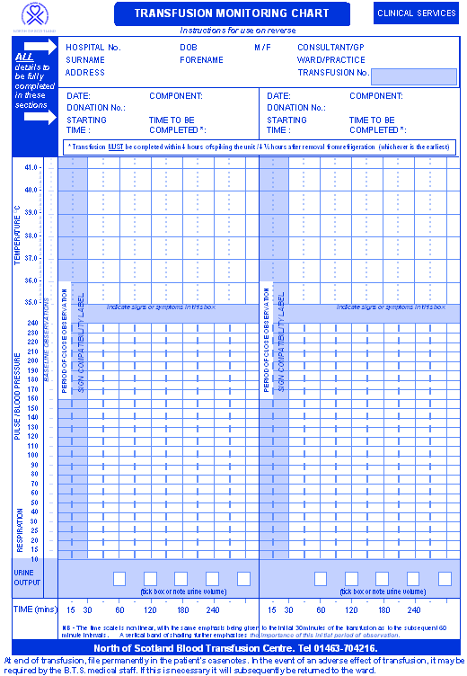
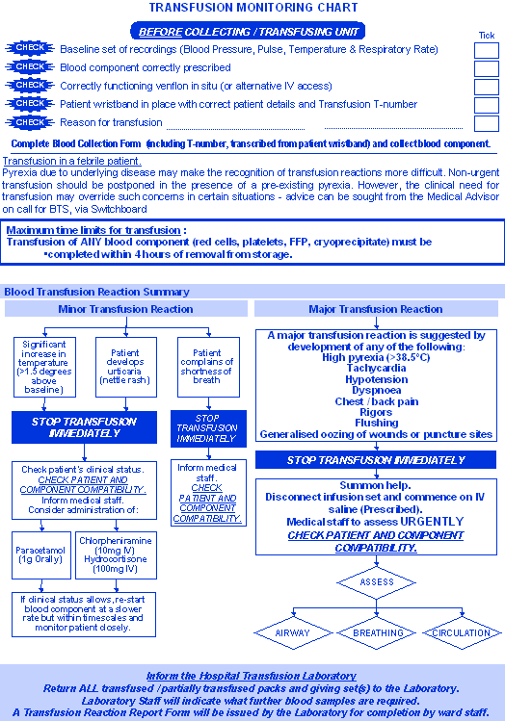
Transfusion Monitoring Chart

Slide 30
IF IN DOUBT
ASK !!!

